Slide 1
Data Analysis for Sociology
Seminar 1
Preliminary data analysis, visualizations, central tendency measure and correlations

Slide 2
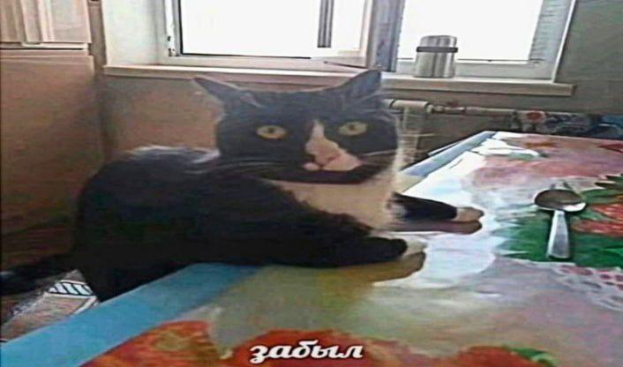
Meme of the week

Slide 3

Quote of the day
“I love deadlines. I like the whooshing sound they make as they fly by”
Douglas Adams

Slide 4

About me
Bachelor in economics HSE, Master in Management, PhD researcher in SPbSU
BI Developer at Avito
Telegram: @moonyloonylad
E-mail: ivlyapin@hse.ru

Slide 5

How we communicate

Slide 6
Formula of the course
Final Grade=0.4×Practice+0.4×Seminars+0.2×Exam

Slide 7
Plan for the seminar
Preliminary data analysis
Central tendency measures
Visualizations
A little bit of paired tests

Slide 8
Where do we get data from?
Kaggle
Public APIs
Web scraping
Company owned databases
Generate data yourself (questionnaires, interviews and so on)

Slide 9
Preliminary data analysis
This step is crucial for understanding what kind of data you have
It includes:
Checking data types
Looking at the data (simple head() function usually suffices)
Using descriptive statistics (central tendency measures)
Visualizing data for better understanding of patterns

Slide 10
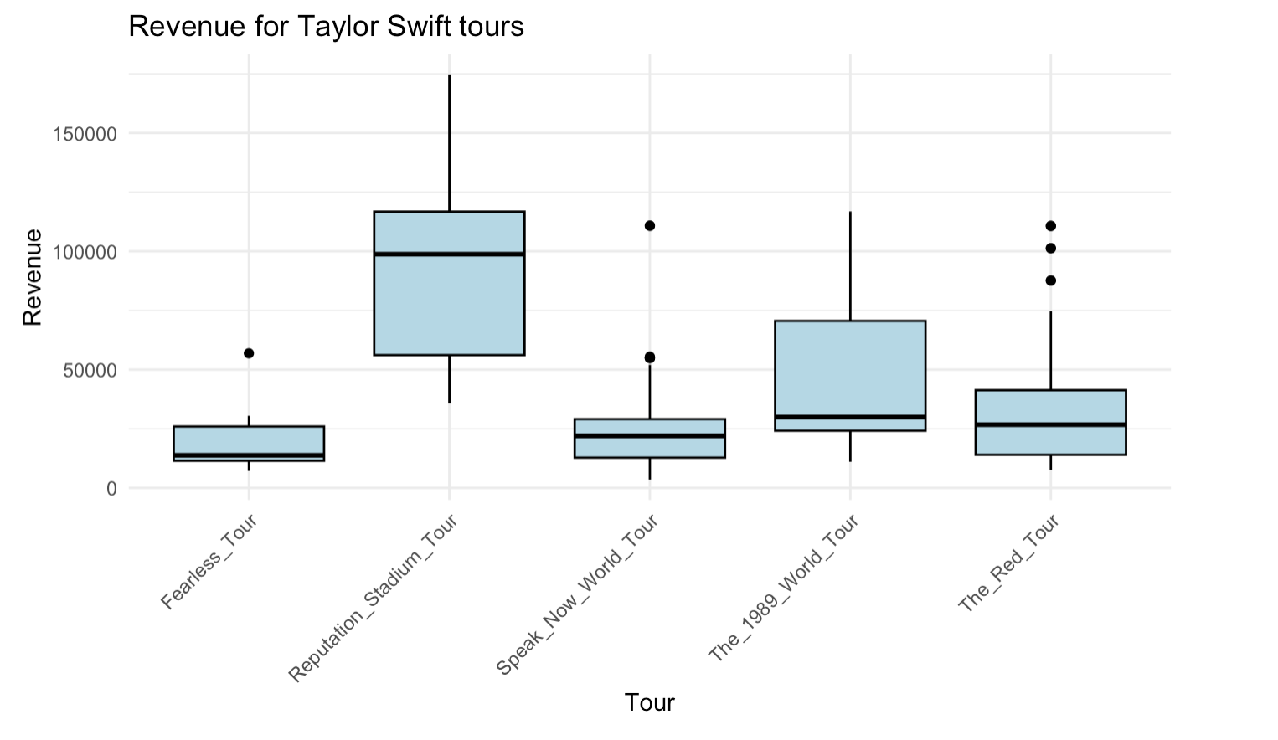
Examples of plots
Boxplot - a plot that show how your values are spread out by plotting them as box that represents 50 % of the distribution and whiskers that represent the rest of the distribution
Well, the graph speaks for itself. At least I hope so

Slide 11
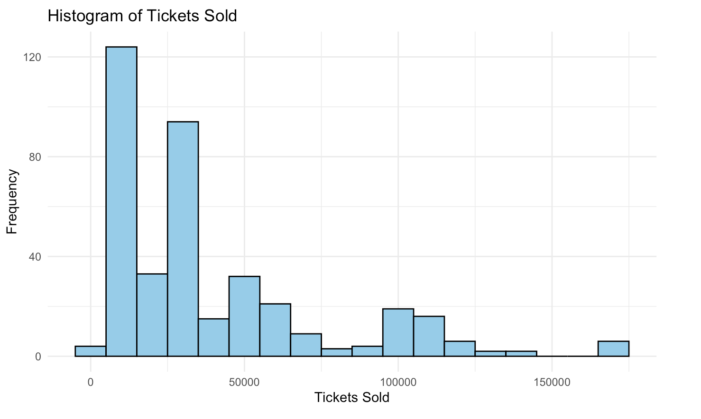
Examples of plots
2. Histogram - a graphical representation of the distribution of a dataset. It displays data by grouping it into intervals, or "bins," and counting how many data points fall into each bin
For instance, this is Taylor Swift ticket sales

Slide 12
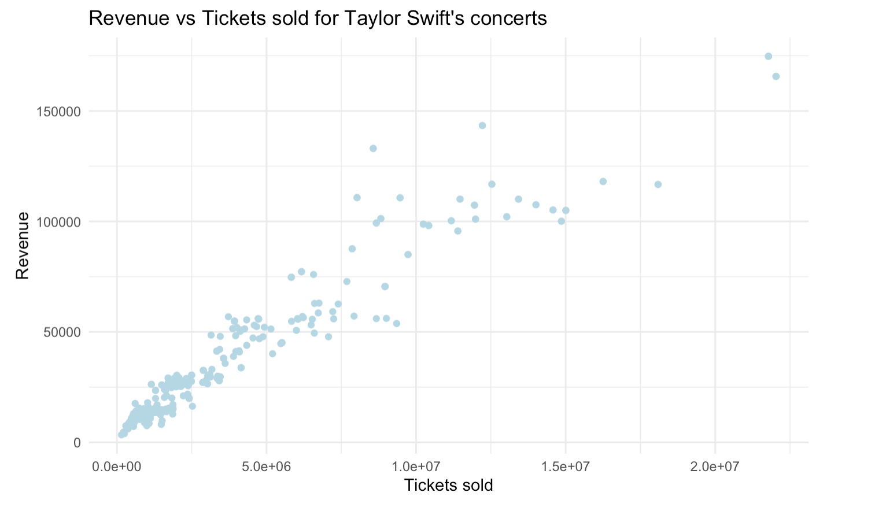
Examples of plots
3. Scatterplot - visualization that displays the relationship between two continuous variables. Each data point in a scatterplot is represented as a dot on a two-dimensional graph
This visuzalization shows obvious relationship between tickets sold and revenue

Slide 13
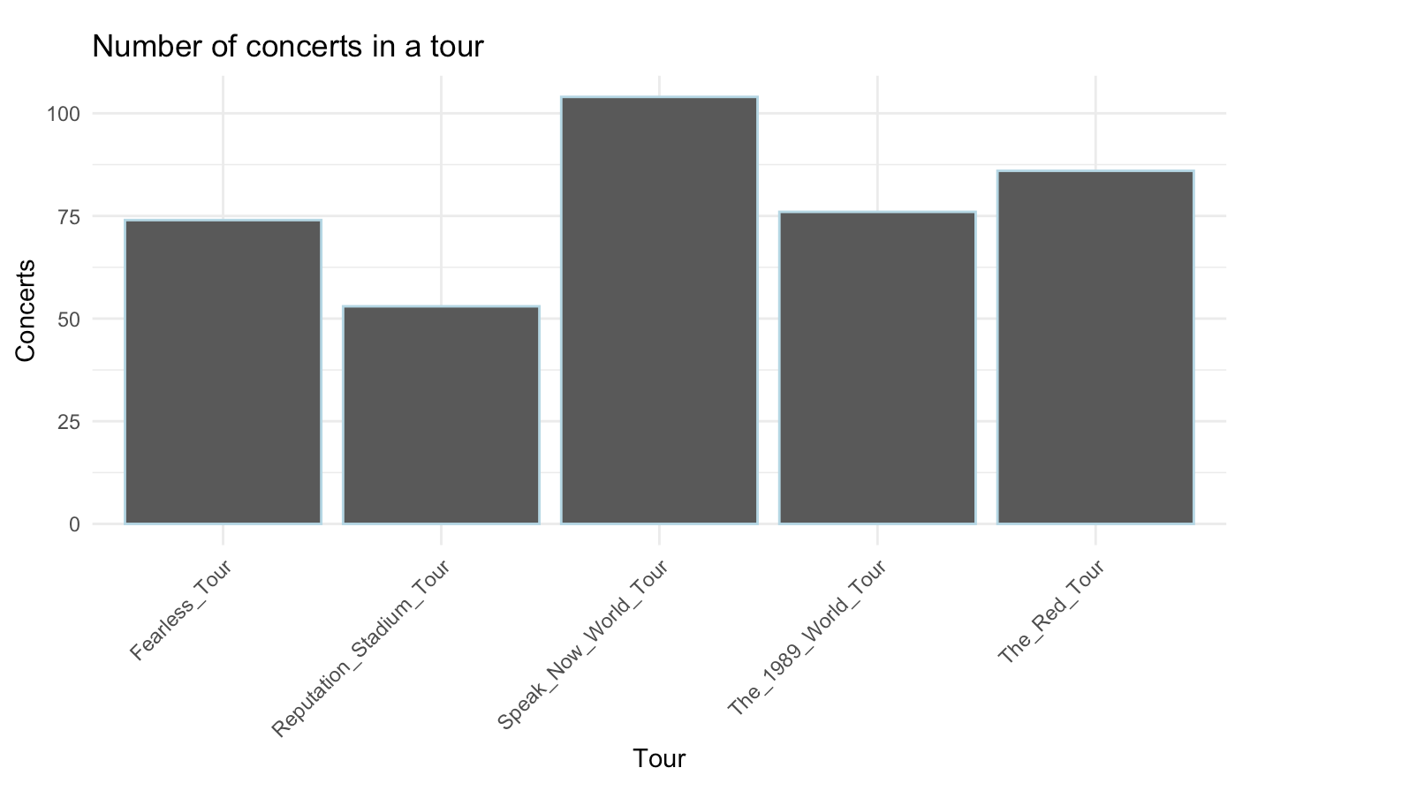
Examples of plots
4. Barplot - a data visualization used to represent categorical data with rectangular bars. The length or height of the bars is proportional to the value or frequency of the category it represents.

Slide 14
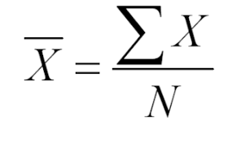
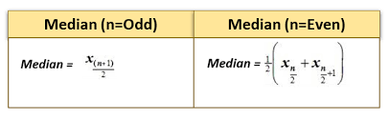
Central tendency measures
There are 3 main central tendency measures:
Mode - the most frequently occuring value in the data
Mean - the arithmetic average of the data
Median - the middle value in an ordered dataset

Slide 15
When to use each measure
Mode | Median | Mean
Categorical data or for identifying repeated values | Skewed distributions or when outliers are present | Symmetrical distributions without outliers

Slide 16
That’s it for today with the theory
Thank you for listening!

